Slide 1
A może coś do picia?
Napój | Ilość
Woda w butelce | 5406
Ice Tea | 3276
Sprite | 3031
Mleko | 2989
Lemoniada | 2886
Cola dietetyczna | 2808
Mleko czekoladowe | 2493
Gorąca czekolada | 2458
Cola | 2210
Cappuccino | 2115

Slide 2
Czy ranking restauracji ma wpływ na cenę?
Drink | Price – Pice Range | Price - score | Price-Ratings
Bottled Water | -0.098953 | -0.007765 | 0.101729
Iced Tea | 0.145698 | 0.005295 | 0.105490
Sprite | 0.095410 | -0.013997 | 0.076029
Milk | 0.357312 | 0.140653 | -0.026484
Lemonade | 0.235289 | -0.014333 | 0.069144
Diet Coke | 0.052846 | -0.023512 | 0.040513
Chocolate Milk | 0.196327 | 0.094793 | -0.039210
Hot Chocolate | 0.091459 | 0.085964 | 0.201477
Coke | 0.046907 | -0.009882 | 0.027394
Cappuccino | 0.056345 | 0.313994 | 0.292044

Slide 3
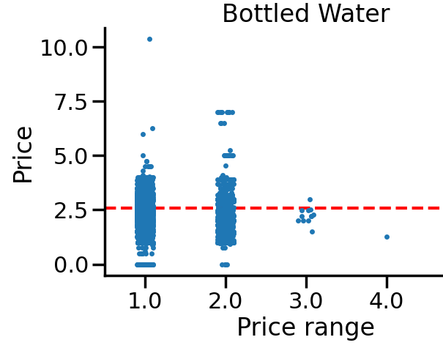
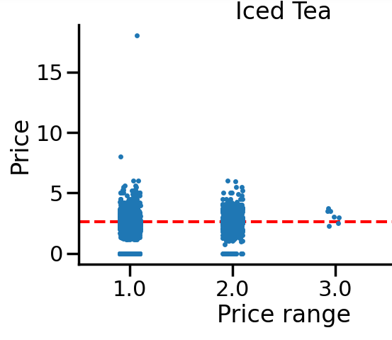
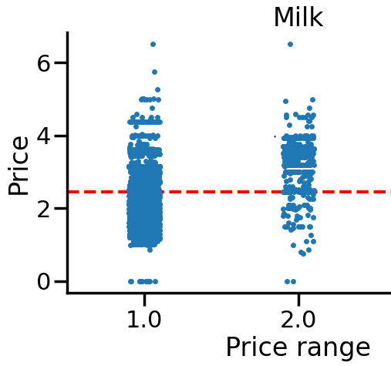
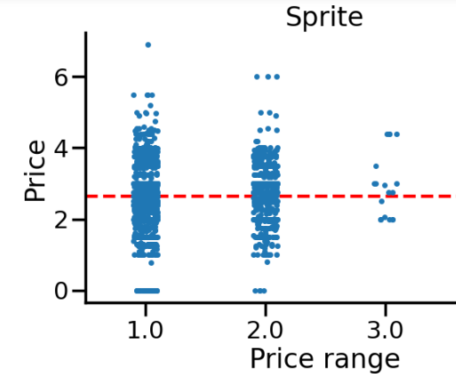

Slide 4
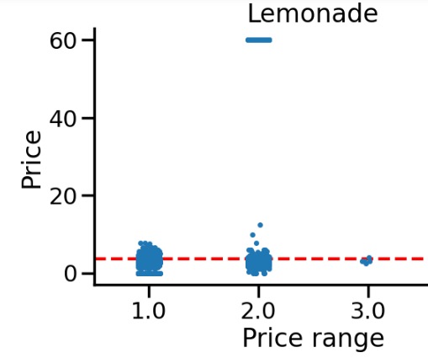
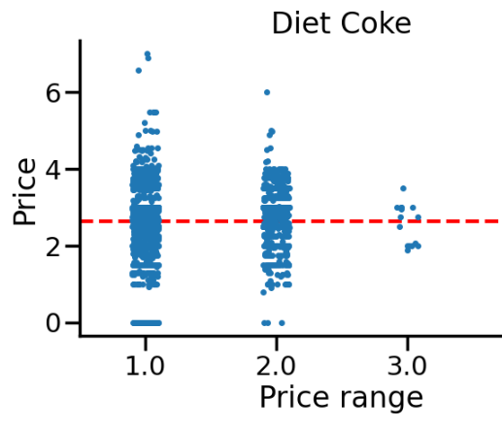
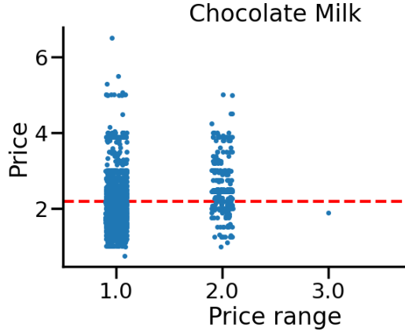
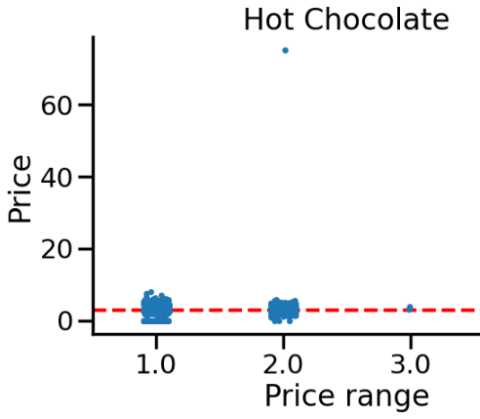

Slide 5
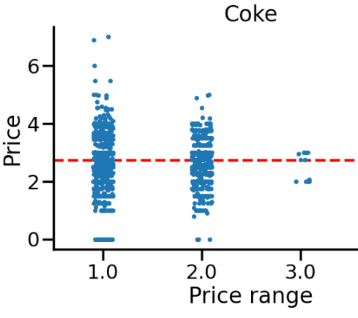
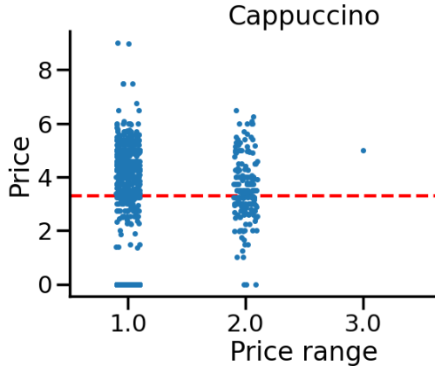

Slide 6
Czy region ma wpływ na cenę?
Drink | Price- region
Bottled Water | 0.016988
Iced Tea | 0.157027
Sprite | 0.002023
Milk | 0.195994
Lemonade | 0.009154
Diet Coke | -0.021190
Chocolate Milk | 0.059313
Hot Chocolate | 0.080501
Coke | 0.027439
Cappuccino | 0.274460

Slide 7
Cena zależna od regionu?
Region | Bottled Water | Iced Tea | Sprite | Milk | Lemonade
CT, MA, ME, NH, NJ, PR, RI, VT | 1.86 | 1.45 | 2.13 | 2.17 | 1.15
DE, NY, PA | - | - | - | 3.15 | 2.65
MD, NC, SC, VA,WV | 2.34 | 2.52 | 2.71 | 2.27 | 3.73
AL., FL, GA, MS TN | 2.19 | 2.34 | 2.70 | 2.31 | 2.41
IN, KY, MI, OH | 1.90 | 2.31 | 2.00 | 1.63 | 2.80
IA, MN, MT, ND, SD, WI | 2.20 | 2.12 | 2.07 | 2.15 | 2.79
IL, KS, MO, NE | 2.32 | 2.77 | 2.68 | 2.61 | 2.70
AR, LA, OK, TX | 2.25 | 2.54 | 2.63 | 2.44 | 3.52
AZ,CO, ID, NM, NV, UT, WY | 2.31 | 2.58 | 2.57 | 2.30 | 4.19
AK, CA, HI, MH, OR, WA | 2.41 | 3.15 | 2.72 | 2.77 | 3.73

Slide 8
Cena zależna od regionu?
Region | Diet Coke | Chocolate Milk | Hot Chocolate | Coke | Cappuccino
CT, MA, ME, NH, NJ, PR, RI, VT | 2.28 | 1.89 | 1.91 | 2.46 | 1.34
DE, NY, PA | - | - | 2.65 | - | 4.25
MD, NC, SC, VA,WV | 2.72 | 2.18 | 2.84 | 2.70 | 2.95
AL., FL, GA, MS TN | 2.84 | 2.31 | 3.00 | 2.76 | 2.95
IN, KY, MI, OH | 2.00 | 1.44 | 3.39 | 2.00 | -
IA, MN, MT, ND, SD, WI | 2.05 | 1.99 | 2.70 | 1.88 | 2.82
IL, KS, MO, NE | 2.88 | 2.50 | 3.38 | 2.64 | 3.91
AR, LA, OK, TX | 2.64 | 2.34 | 3.02 | 2.67 | 3.54
AZ,CO, ID, NM, NV, UT, WY | 2.56 | 2.12 | 2.20 | 2.59 | 4.02
AK, CA, HI, MH, OR, WA | 2.70 | 2.31 | 3.42 | 3.13 | 4.30

